Slide 1
Field Training Officer
Functions and qualities of field training officer

Slide 2
Reasons why the FTO is One of the Most Important Police Employees
Teaching young officers the right way to do the job (Cushion, 2018). During the training, officers are taught to expect the worst and also strategies to counter situations that emerge. As a result, young officers conduct their duties appropriately and timely.
Notes:
One of the main functions of FTO is to teach young officers the right way to do the job. This is fundamental since it enables the young officers to accept the roles and duties that the profession demands of them. This enables them to perform excellently in missions that are meant to improve the lives of the public (Cushion, 2018).

Slide 3
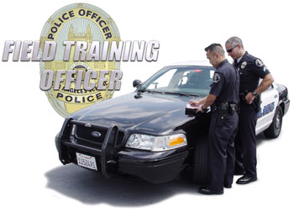
Reasons why the FTO is one of the Most Important Police Employees (cont......)
It can be one of the most rewarding assignments in all of law enforcement (Edwards& Meader, 2015). This may mainly involve salaries although they tend to vary depending on agency and location. Generally, assignments are paid well hence encouraging more officers to take these positions.
It promotes safety and reduce crimes. Safety in the society is a catalyst to development and growth since the environment is conducive.
Notes:
FTO is one of the best careers in terms because officers enjoy better payments and services such as free transport and residence (Edwards & Meader, 2015). Officers tend to understand the law in a better way hence being able to perform their duties responsibly and timely. Again, officers are provided a platform that they can use to expand on other careers in law. The FTO is also responsible for the promotion of safeness and reduction of crimes in the streets. This aids in the achievement of a free and safe community which accommodates all.

Slide 4
Major Qualities of FTO
Translate experience and understanding into training (Idris, 2018). FTO’s are usually tasked with roles to pass training to young officers practically. Majority of the situations that are likely to happen require practical application to counter them.
Notes:
One major quality of the FTO is to translate experience and understanding into training across the particular departments. This makes it easy for the trained officers to perform excellently in field operations and missions since they have already become competent and experienced (Idris, 2018). Through this, crimes and dangerous situations such as attacks are likely to be reduced.

Slide 5
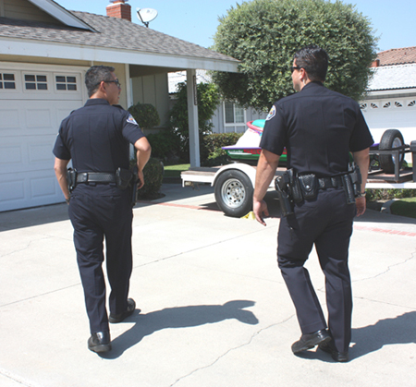
Major Qualities of FTO (Cont......)
Gain the attention, participation, and trust of the trainee (Cushion, 2018). FTO’s are bound to get interact with the trainees during the training since they are always solving issues and circumstances as they train. According to Cushion (2018), the name aspects are best achieved through training which involves interaction while learning of new skills.
Notes:
FTO Officers are in a position to gain attention, participation as well as the trust of the trainee. According to Cushion (2018), the name aspects are best achieved through training which involves interaction while learning of new skills is taking place. As such, very high levels of competence and responsibility are attained as a result of participation.

Slide 6
Major Qualities of FTO (Cont............)
Develop awareness, decision making skills, and confidence in the trainee (Idris, 2018). Officers improve decision making skills and confidence hence enabling trainees to solve things on their own effectively without mistakes. In addition, the officers are able to educate the public of better precautions and safe methods for protection.
Notes:
FTO’s are usually tasked to develop awareness, decision making skills and confidence in the trainee (Idris, 2018). This enables the trainees to be make sound and logic arguments that have the potential of improving the lives of the public. In addition, the officers are able to educate the public of better precautions and safe methods for protection.

Slide 7
References
Cushion, C. J. (2018). Exploring the Delivery of Officer Safety Training: A Case Study. Policing: A Journal of Policy and Practice.
Edwards, S., & Meader, D. (2015). Officer Safety Initiatives.
Idris, M. (2018). The Impact of Education and Training, Work Discipline and Organizational Culture on Employee’s Performance: The Study of Disaster Management and Fire Department in Palembang City, Indonesia. International Journal of Human Resource Studies, 8(3), 1-18.

